Slide 1
SOAR –Setting Objectives and Achieving Results African American Parent Network
New Albany School

Slide 2
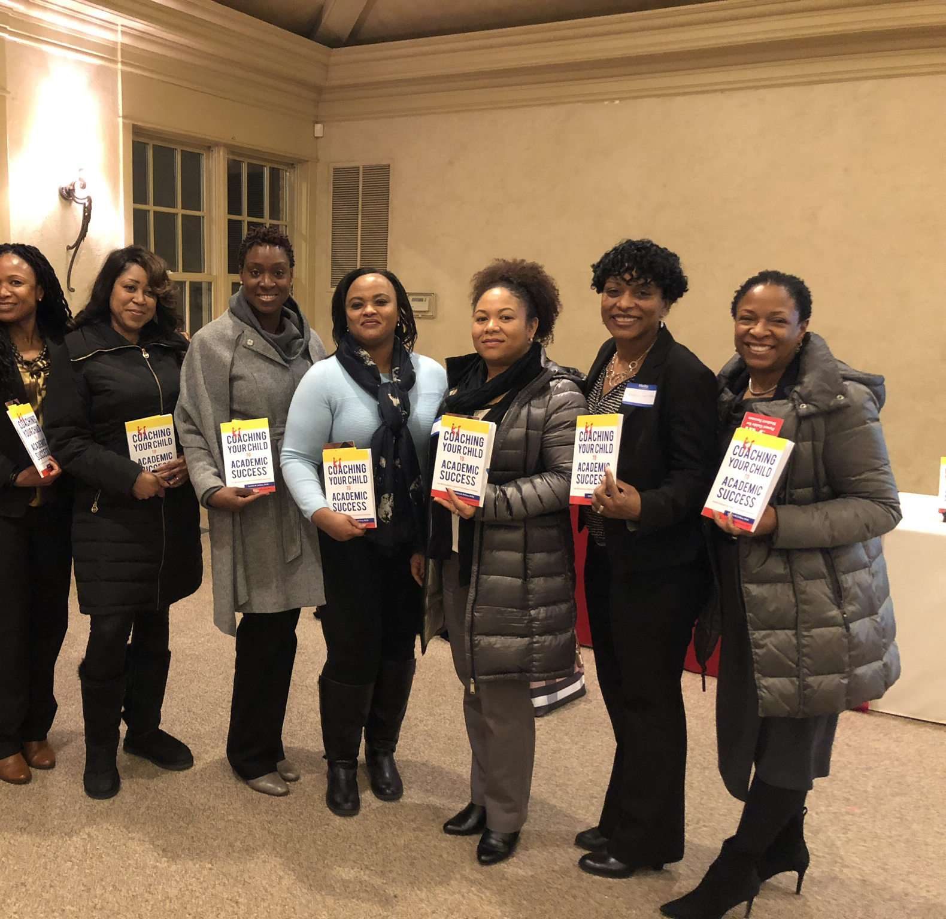
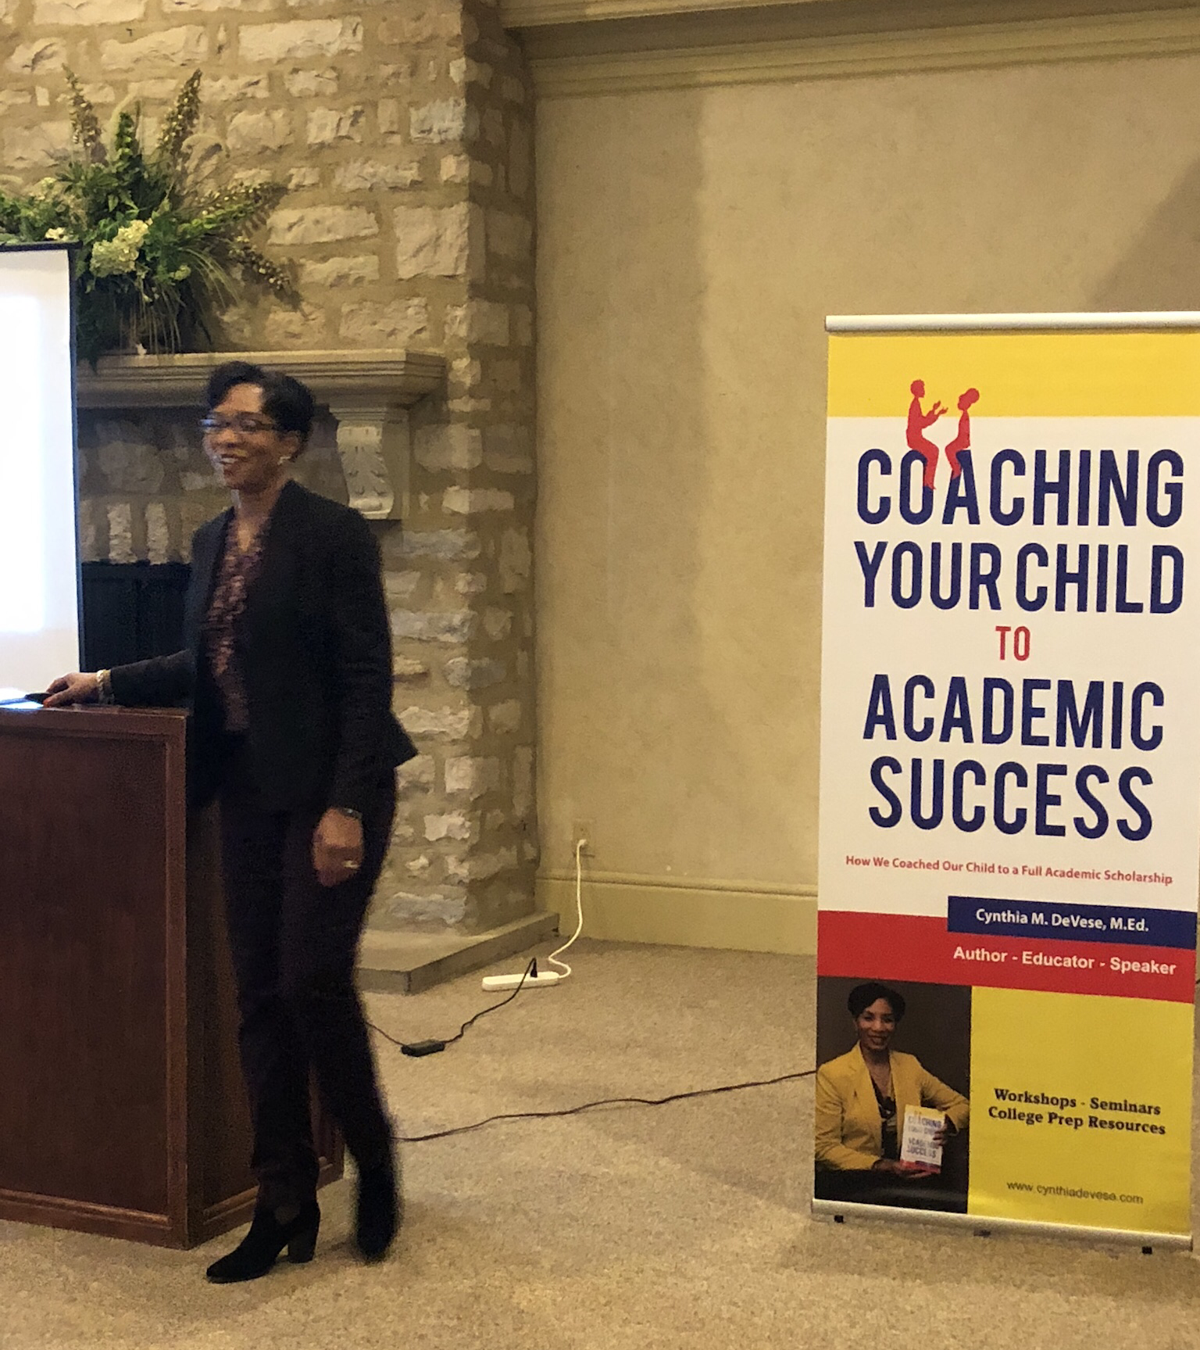
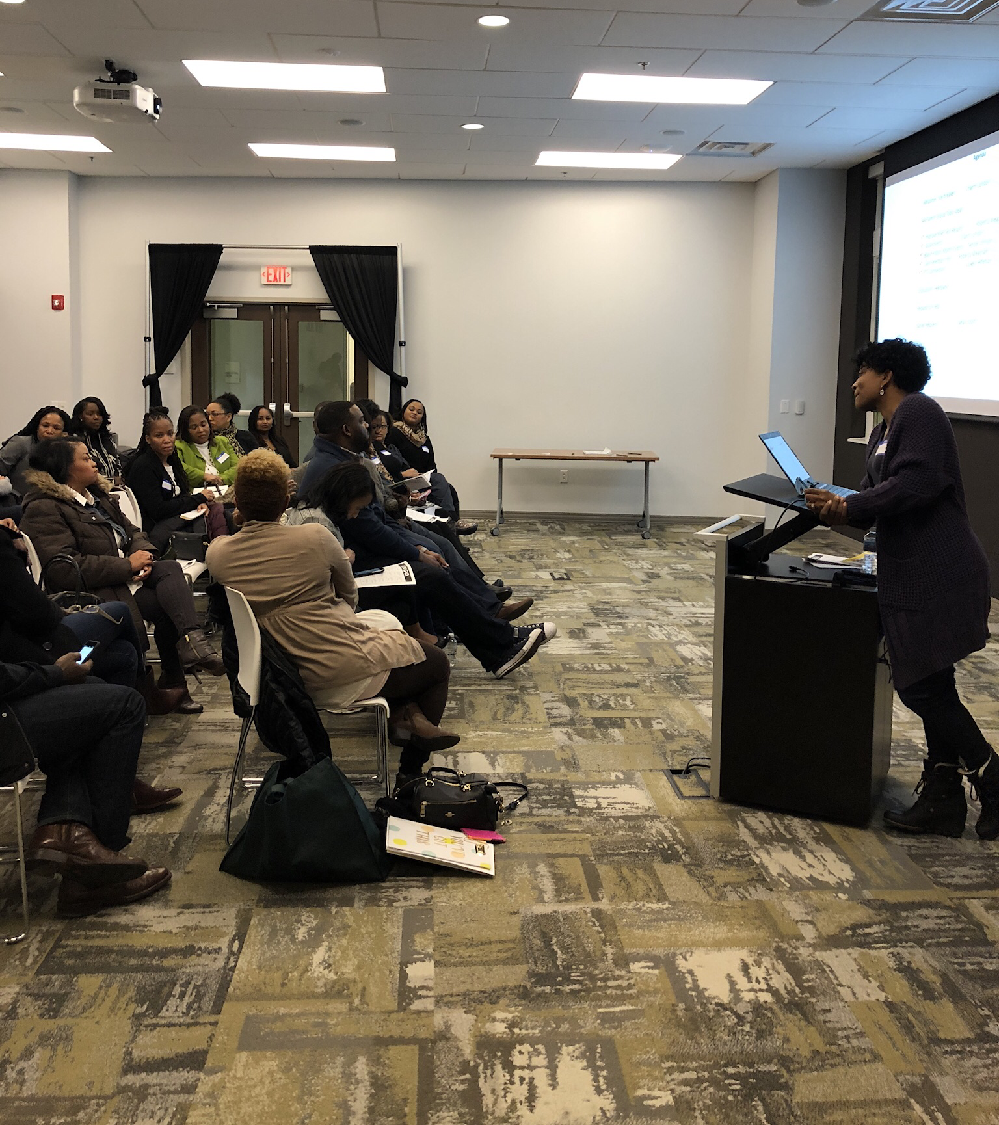
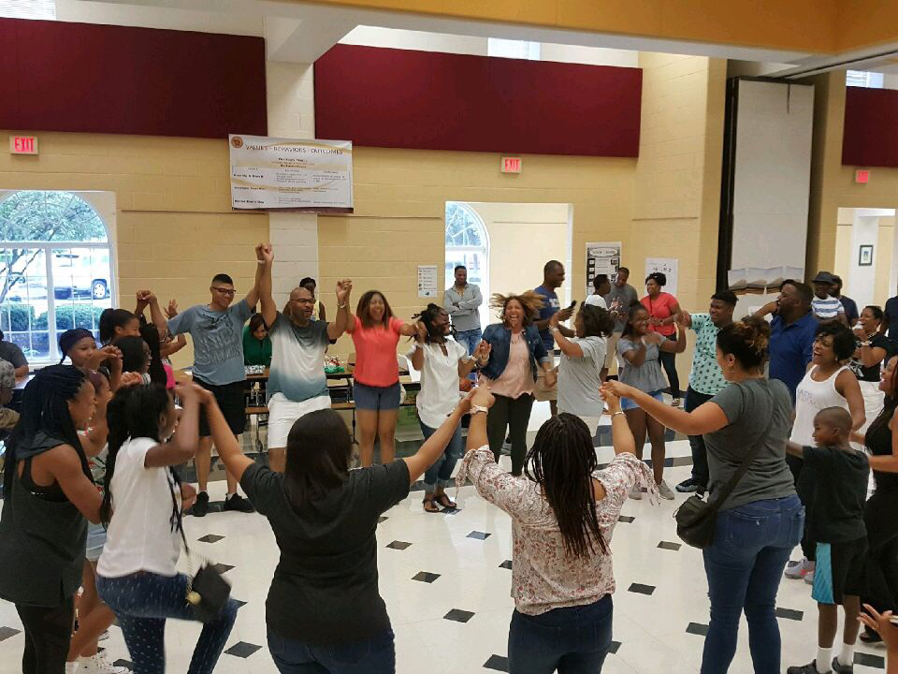
Mission: Active participants and partners in the academic excellence and well-being of our students, while building cultural awareness in the NA learning community

Slide 3
Our Group
Parents of all age groups
Meeting monthly during the school year
~80 participants currently
Areas of interest
Improve test scores
Support Improvement Plan
Increase the number of African American Faculty
Increase parent involvement
Create a partnership with the Administration

